Slide 1
3252 – Big Data
German Credit Data:Predicting Loan Credit Risk using Apache Spark Machine Learning
Isaac Aktam

Slide 2
Business Case
What are we trying to predict? - Whether a client will be eligible for a loan given client’s socio-demographic features.
Why do we care? - Banks and financial instutions run following risks:
  If the applicant is a good credit risk, i.e. is likely to repay the loan, then not approving the loan to the person results in a loss of business to the bank
  If the applicant is a bad credit risk, i.e. is not likely to repay the loan, then approving the loan to the person results in a financial loss to the bank

Slide 3
Dataset
Statlog (German Credit Data) Data Set
Type: Financial
Year: 1994
Number of instances: 1000
Number of categorical features: 14
Number of numerical features: 6
Number of labels: 1 (700 not credtiable, 300 creditable)
Link: https://archive.ics.uci.edu/ml/datasets/Statlog+(German+Credit+Data)

Slide 4
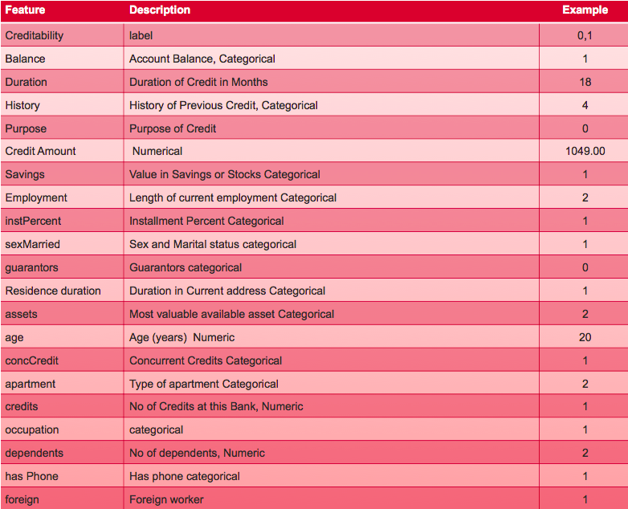
Dataset continued

Slide 5
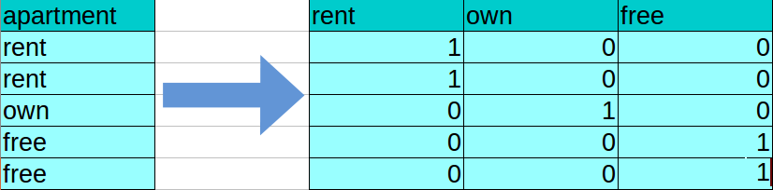
Feature engineering
Amount per age = Loan amount divided by age of the borrower
Amount per duration = Loan amount divided by loan period
Duration per age = Loan duration divided by age of the borrower
One-hot-encoding – transformed all categorial data into numerical data. E.g.:

Slide 6
Insights from Graphs: Count sexMarried per Purpose
"purpose" of a loan; QUALITATIVE
0 : car (new)
1 : car (used)
2 : furniture/equipment
3 : radio/television
4 : domestic appliances
5 : repairs
6 : education
7 : vacation – not available
8 : retraining
9 : business
10 : others
"sexMarried"; QUALITATIVE
1 : male : divorced/separated
2 : female : divorced/separated/married
3 : male : single
4 : male : married/widowed
5 : female : single

Slide 7
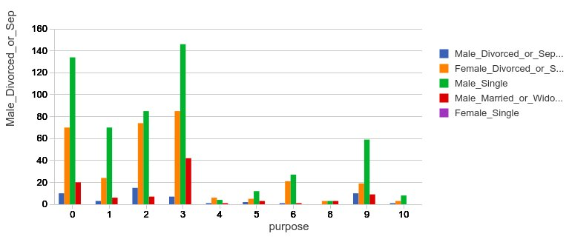
Insights from Graphs: Count sexMarried per Purpose
Single males used loans mostly to buy a new car and radio/television
Female divorced/separated used loands mostly to buy a new car, furniture/equipment, and radio/tevelision

Slide 8
Models
Scaling:
  Standardization (mean 0, standard deviation 1)
Binary Evaluator:
  Area Under the Curve
Classifiers:
  Random Forest
  LightGBM
  XGBoost
  SVM (Winner!)
Calculated accuracies on:
  Non-tuned models
  Tuned models

Slide 9
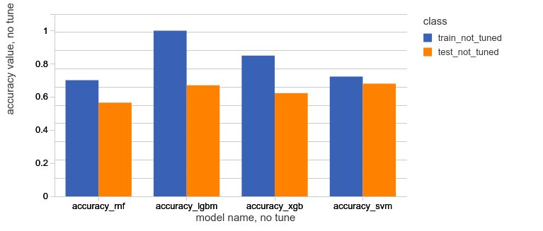
Results. No tuning.
Accuracy on Train and Test sets – No Tuning

Slide 10
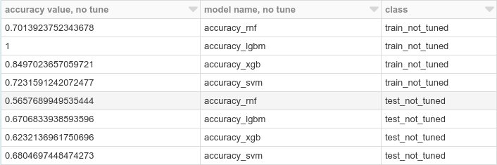
Results. No tuning.
Accuracy on Train and Test sets – No Tuning

Slide 11
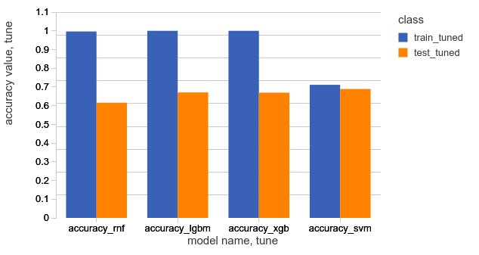
Results. Tuned
Accuracy on Train and Test sets – tuned.

Slide 12
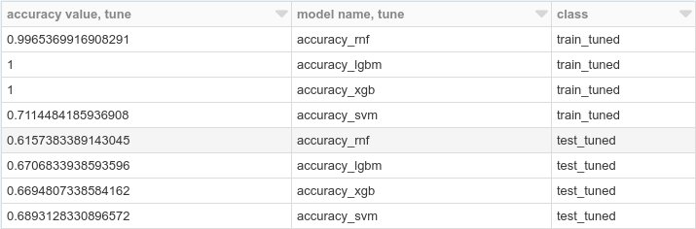
Results tuned
Accuracy on Train and Test sets – tuned.

Slide 13
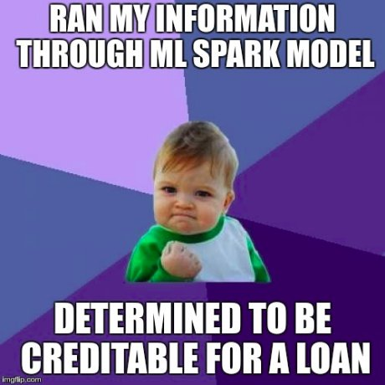
Thank you!

